Slide 1
SDN and WN security
Saim Ghafoor
Week 4 Lecture 4-2
Network virtualization, Network Slicing, Data centre

Slide 2
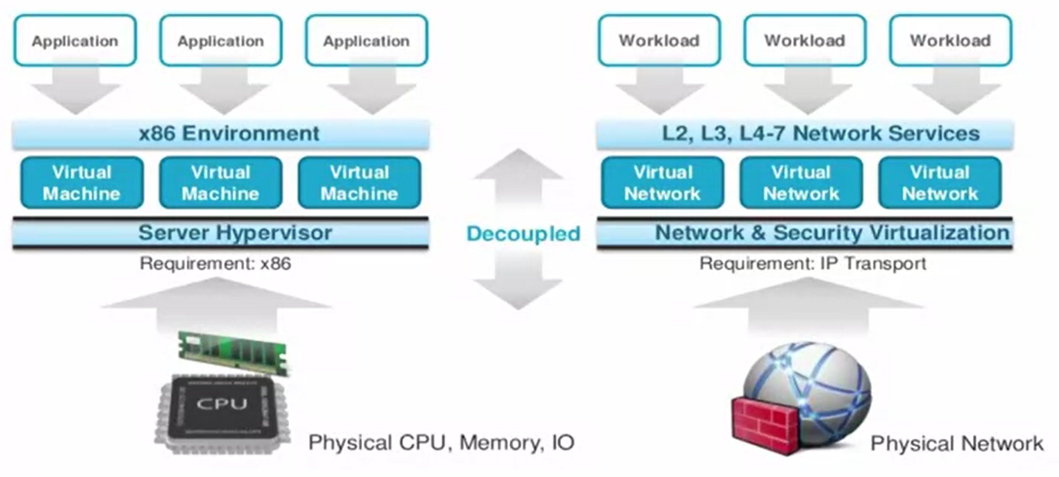
What is network virtualization?
Abstraction of the physical network
Support for multiple logical networks running on a common shared physical substrate
A container of network services
Aspects of the network that can be virtualized
Nodes: virtual machines
Links: Tunnels (ethernet GRE)
Storage

Slide 3
Motivation for network virtualization
One size fits all in network infrastructure
Cost
Easy management and flexibility
Rapid innovation
New forms of network control
Simplified programming and operations
SDN does not inherently abstract the details of the physical network
SDN separates the control and data plane. NV helps SDN to achieve this.

Slide 4
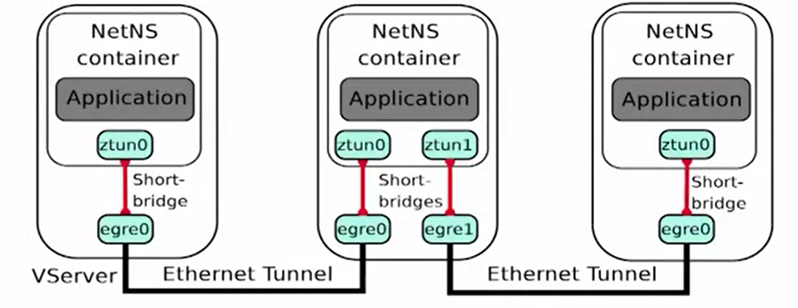
Example Virtual Network Links: EGRE
Ethernet GRE (EGRE) Tunnelling: Ethernet frames from virtual hosts are encapsulated in IP packets
One way is to take Ethernet frames generated by applications and encapsulate them in IP packets.
Two nodes have the appearance of being connected by a p2P ethernet link. In an actual connected multihop
Other approaches: VXLAN

Slide 5
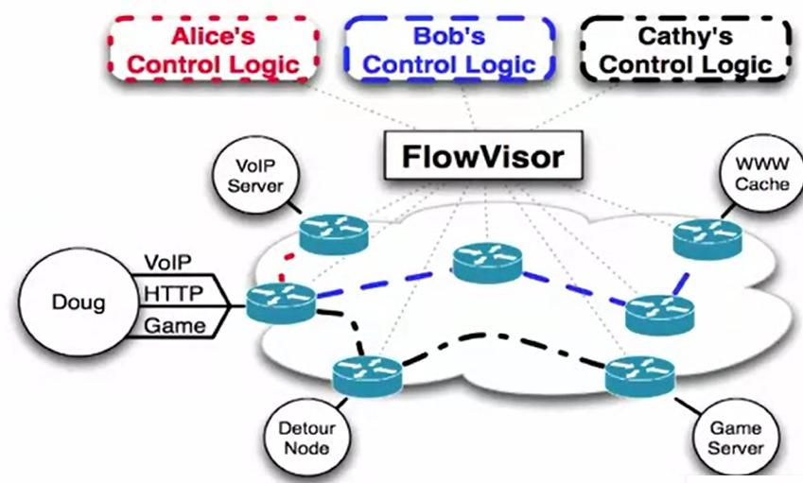
FlowVisor: Virtualizing Network Control
FlowVisor virtualizes network control by letting experimental traffic run in parallel on the production network with the real user and real production traffic
User (D) can let different flows be controlled by different group of researchers
Virtualization of control based on ‘flow space’(IP add, port, etc)

Slide 6
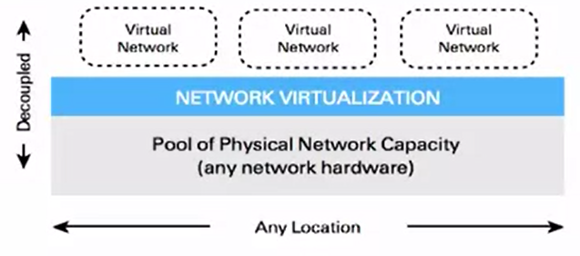
Rapid deployment of services: Nicira Network Virtualization Platform
Deployment of new services (another application of network virtualization)
Abstraction layer between hosts and underlying network
OpenvSwitch in host hypervisors: abstraction layer
Managed by distributed controller

Slide 7
Nicira NVP: Applications
Dynamic workload placement
Multi-tenant data centers
Creation of isolated virtual networks for each tenant
Dynamic security enforcement
Central management of security policies
Enforcement per virtual network
Independence from VLAN limits

Slide 8
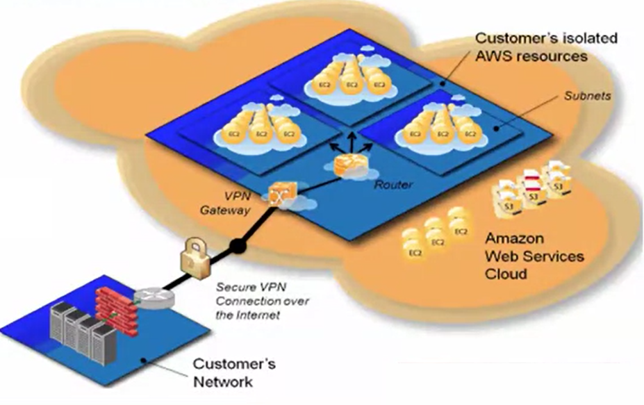
Dynamic Scaling of Resources: Amazon VPN
Connect logically isolated VM instances to existing network
Connection to existing infrastructure via VPN
Allows customers to define their own network, address space, etc
Extend existing enterprise data center
VPN between Amazon VPC and data center
Applications/Benefits
Dynamic Scaling
Disaster recovery
Manageability

Slide 9
Many other examples of Nw Virtualization
Wide-Area Virtual Networks
Virtual ‘Network in a Box’
Open vSwitch, Citrix, Vyatta, OpenSolaris, Microsoft Virtual Server
Network functions virtualisation
Unification of middlebox functions (firewalls, etc)

Slide 10
Network slicing

Slide 11
Network Slicing
Divides the production network into logical slices
Each slice controls its own packet forwarding
Users pick which slice controls their traffic
Existing production services run in own slice
Enforce strong isolation between slices
Actions in one slice do not affect another
Each slice can mirror a production network
Production
Testing
Research

Slide 12
Layer | Function | Visualization Idea
Infrastructure Layer | Physical network (radio, servers, routers) | A map of shared hardware nodes
Network Slice Layer | Virtualized logical slices | Colored overlays (e.g., red for eMBB, blue for URLLC)
Service Layer | Applications/services running on slices | Icons like video streaming, sensors, autonomous car

Slide 13
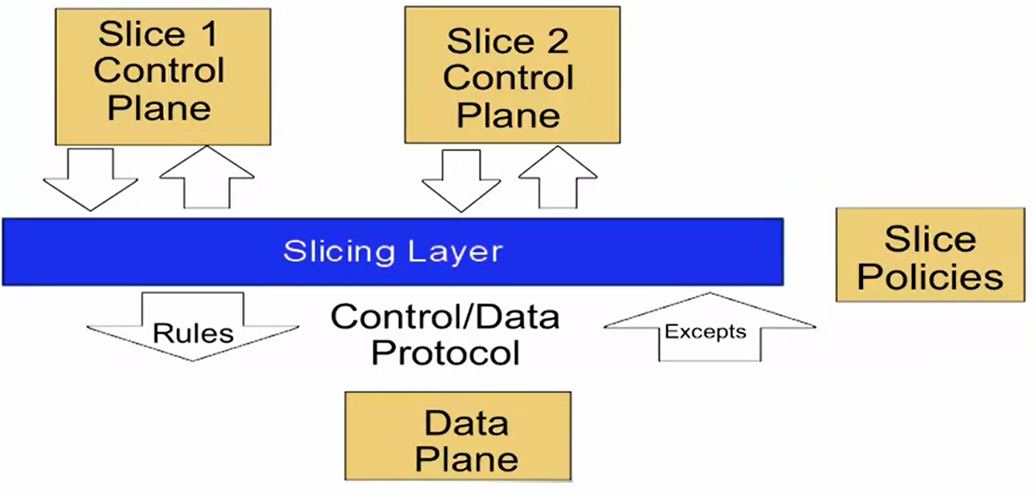
Add a Slicing Layer between planes
Basic idea: Add a layer between control and data plane. So, each control slice believes that it owns the data path
The slicing layer then has the responsibility of enforcing isolation between these slices
Policies defined at the slicing layer control which slices should access or control over different parts of the data plane.

Slide 14
Why Slice the Network?
Multiple administrative groups
Different departments on a campus
Multiple customers
Tenants in a shared data center
Researchers on a shared infrastructure
Experiments vs operational network
Support research without breaking real services
Expanding networks foot print
Lease components in another carriers networks
Multiple services or applications in one domain

Slide 15
Slicing: Forwarding and Policy
Data plane remains unmodified (no performance penalty)
Policy: Specifies resource limits for each slice
Link bandwidth
Maximum number of forwarding rules
Topology
Fraction of switch/router CPU

Slide 16
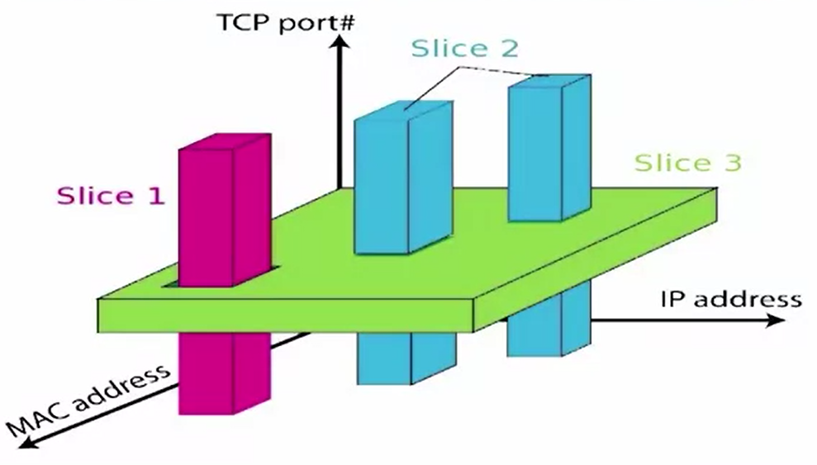
Flow Space: Which packets does the slice control?
One way to slicing a control is by using a concept FlowSpace
Slices can also be defined based on group of packets who shares one or more of the fields in common.

Slide 17
Example: FlowVisor
FlowVisor: An OpenFLow controller that acts as a transparent proxy between OpenFlow switches and multiple OpenFLow controllers.
Slices:
any combination of switch ports (L1),
src/dst ethernet address or type (L2),
src/dst IP address or type (L3), and
src/dst TCP/UDP port or ICMP code/type (L4)
Enforces isolation between each slice

Slide 18
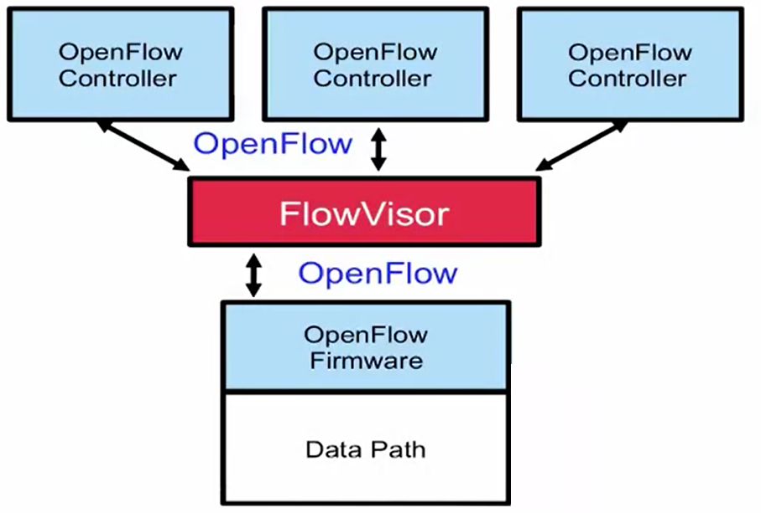
FlowVisor on OpenFlow
FlowVisor sits between multiple OF controllers (operating in control plane) and OF enabled switches (in dataplane)
Performs different types of policy check
Is this rule allowed?
If that controller is allowed to install that rule in a switch
Who controls this packet?
Which controller controls a particular packet?

Slide 19
Slice | Purpose | Characteristics
eMBB | Enhanced Mobile Broadband | High throughput, video streaming
URLLC | Ultra-Reliable Low-Latency Communication | Mission-critical, low latency
mMTC | Massive Machine Type Communication | IoT devices, low power

Slide 20
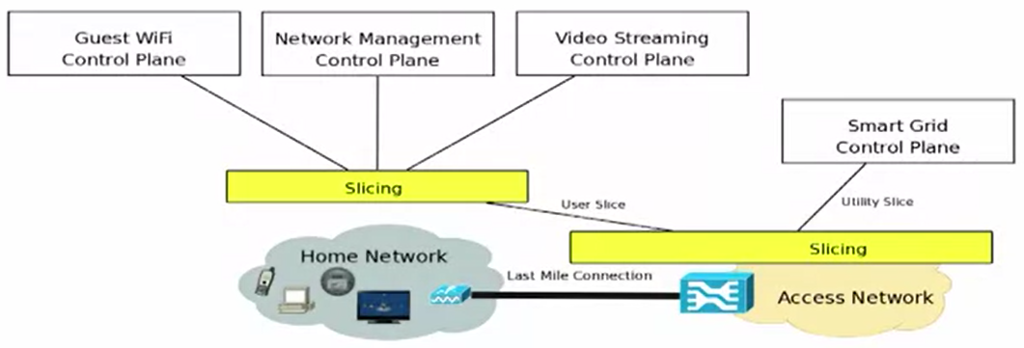
Examples: Ways to slice the network
By switch port
Basically the same functionality as VLANs
By application (TCP port)
Would require some more complicated access control lists
Dynamism possible a bit more difficult without SDN
Applications:
Testing
Home networks and IoTs

Slide 21
Multi-Tenant Data center
Single physical data center shared by many tenant users
Customers (Amazon)
Applications/services (Mail, Search etc)
Developers
Challenges
Workloads require different topologies, services
Address space overlaps with physical network

Slide 22
Multi-Tenant Data centre Architecture
Each host in the data center has multiple VMs
Each host has a hypervisor with an internal switch
Switch forwards to local VM or another hypervisor
Need: Network hypervisor to build right network abstractions for tenants
Control Abstraction: Tenants define a set of logical network data-plane elements that they can control
Packet abstraction: Packets sent by endpoints should see the same service as in a native network

Slide 23
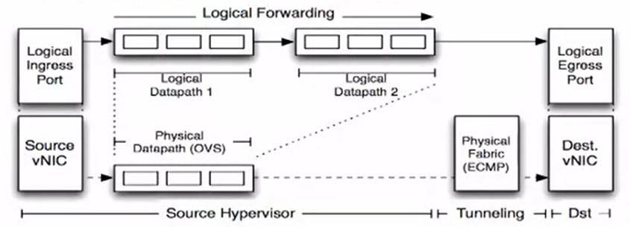
Implementing abstractions
Network hypervisor sets up tunnels between host hypervisors
Multicast implemented as an overlay service
Physical network sees IP packets
Centralised SDN controller configures the hosts’ virtual switches
Logical Datapath implemented entirely on the sending host
Implementing Logical Datapath
Tunnels endpoints are virtual switches running on host hypervisors
Implemented with open vSwitch
Controller cluster can
Modify flow table entries
Set up tunnels

Slide 24
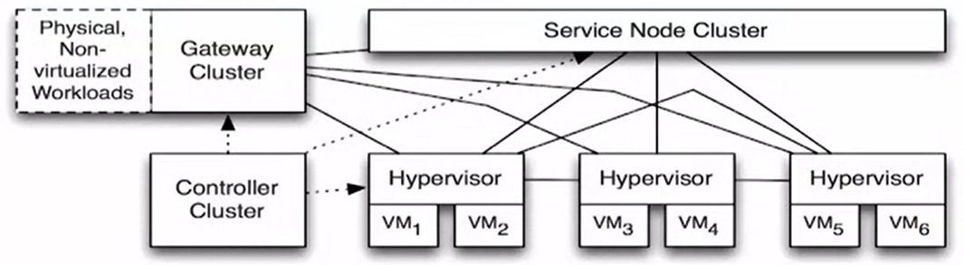
Controller structure
Hypervisors and physical gateways provide the controller with location and topology information
Service providers configure the controller
Forwarding state pushed to OVS via OpenFlow

Slide 25
Challenges
Datapath design: Making software switching at end hosts fast
Scaling the computation: computing the logical datapaths and tunnels

Slide 26
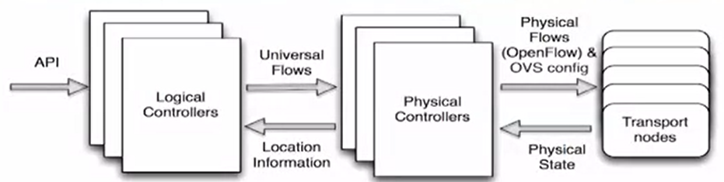
Making data path fast
Exact match flows in kernel
User space program matches on full flow table, installs exact match in the kernel
Future packets for the same flow are matched in kernel
Hardware offloading of encapsulated packets requires some additional tricks.

Slide 27
Scaling controller computation
Two layer distribution controller
Logical controllers: Compute flows and tunnels for logical datapaths
Physical controllers: Communicate with hypervisors, gateways, and service nodes
Logical controller avoids dealing with the full mesh of tunnels

Slide 28
What is Network Functions Virtualization?
Network functions virtualization (NFV) is the replacement of network appliance hardware with virtual machines. The virtual machines use a hypervisor to run networking software and processes such as routing and load balancing.
A new approach for deploying middlebox functions on virtual appliances in the network

Slide 29
Why network functions virtualization?
NFV allows for the separation of communication services from dedicated hardware, such as routers and firewalls.
This separation means network operations can provide new services dynamically and without installing new hardware.
Deploying network components with network functions virtualization takes hours instead of months like with traditional networking.
The virtualized services can run on less expensive, generic servers instead of proprietary hardware

Slide 30
How does network functions virtualization work?
Essentially, network functions virtualization replaces the functionality provided by individual hardware networking components.
This means that virtual machines run software that accomplishes the same networking functions as the traditional hardware.
Load balancing, routing and firewall security are all performed by software instead of hardware components.
A hypervisor or software-defined networking controller allows network engineers to program all of the different segments of the virtual network, and even automate the provisioning of the network.

Slide 31
Benefits
Reduced Capex
Reduced time to market
Elastic scaling
Targeted services
Vendor neutrality
Use cases
Virtualized services for enterprises
Virtual CDNs
Virtualised mobile core networks
Integrate production/testing

Slide 32
Function Elements, not Middleboxes
WAN Optimizer = caching + Deduplication + compression + Encryption + Forward Error Correction + Rate Limiter
Application Firewall = IP defragmenter + Application Detection Engine + Logger + Blocker
Snort = IP Defragmenter + Pre-processing + Misuse Detection Engine + Logger

